Slide 1
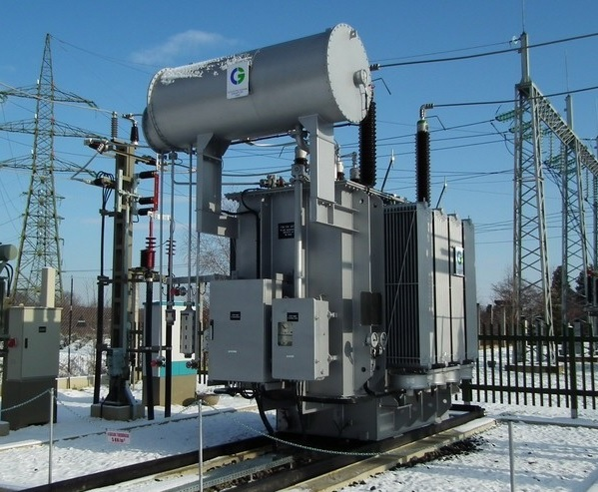

dr. Zsuzsanna Gaál-Szabó, head of company, Energochem Ltd., Hungary
Examination of lifetime of railway transformers
INNORAIL 2015
zsuzsagsz@gmail.com

Slide 2
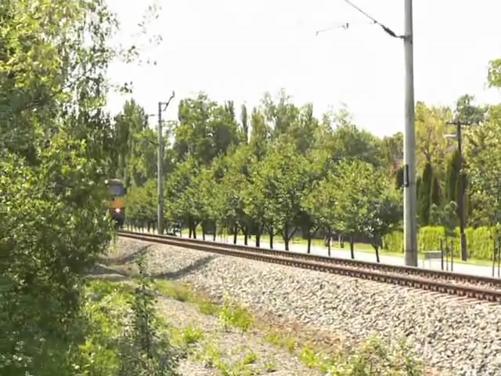

Slide 3
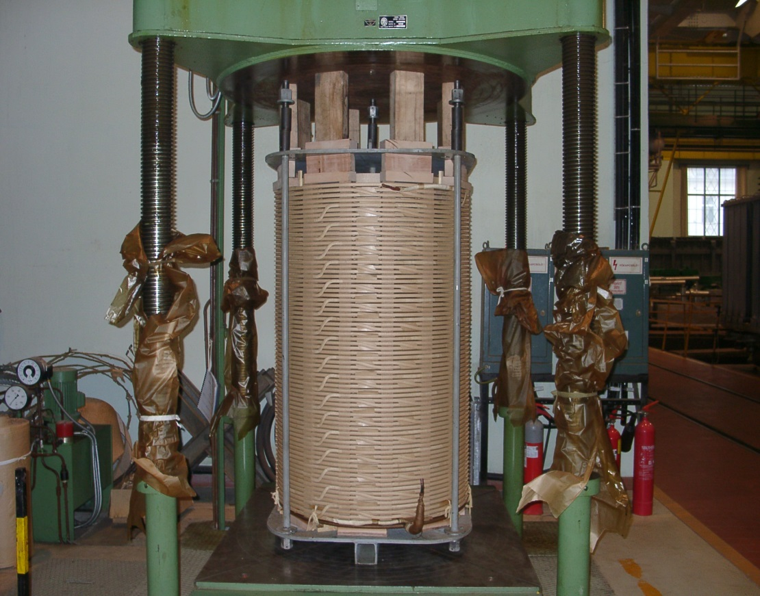
Lifetime of transformer =
Lifetime of insulating paper

Slide 4
Mass of paper and oil in transformer

Slide 5
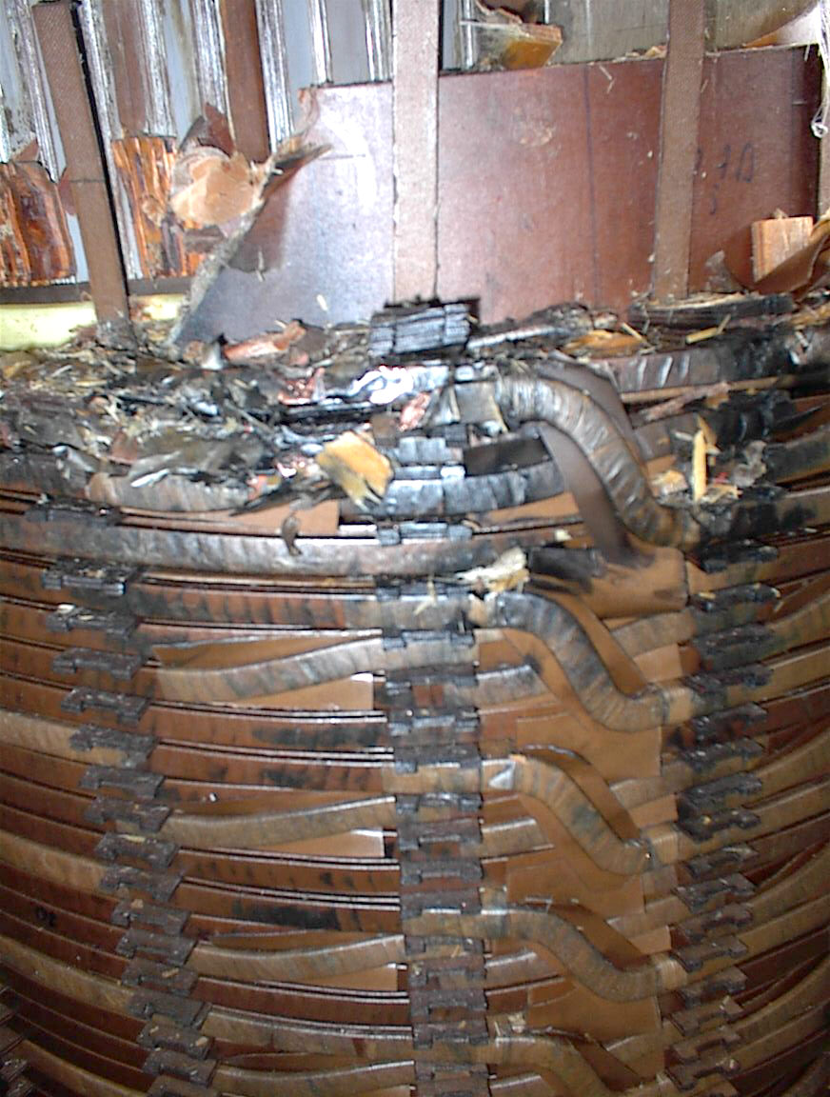
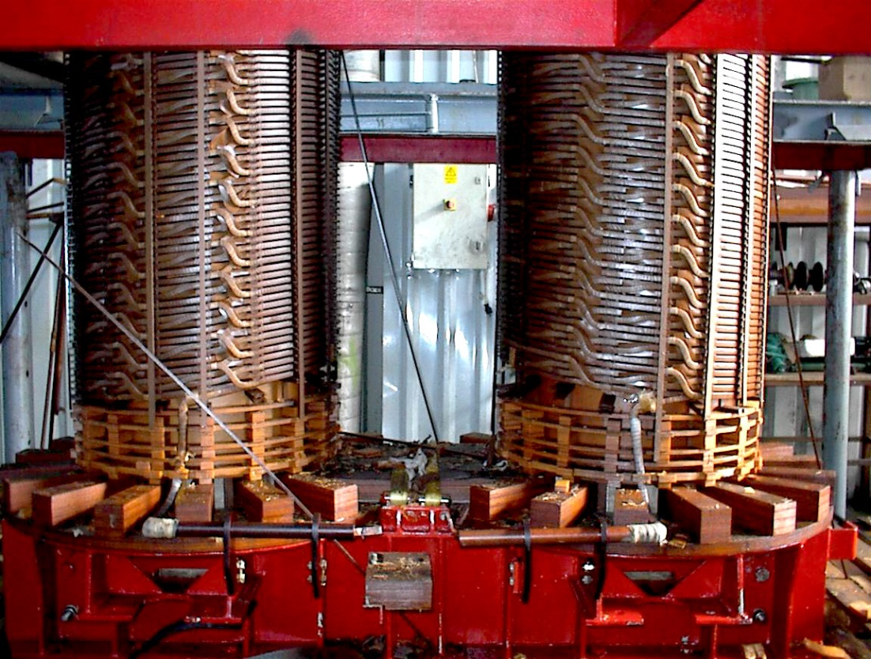

Slide 6
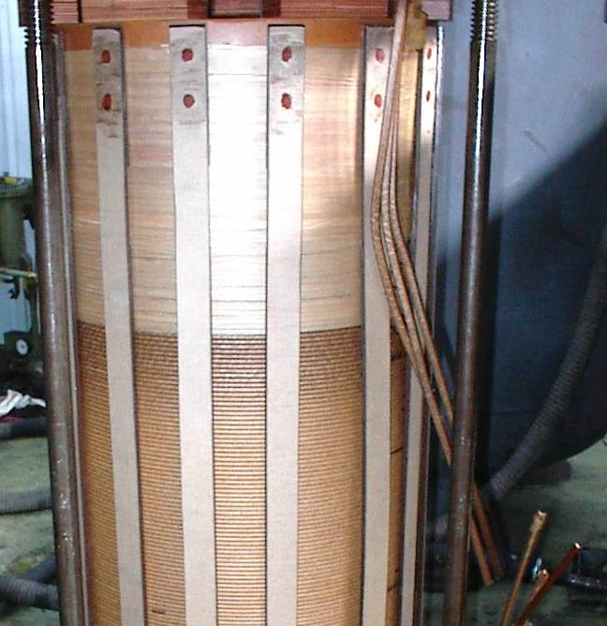
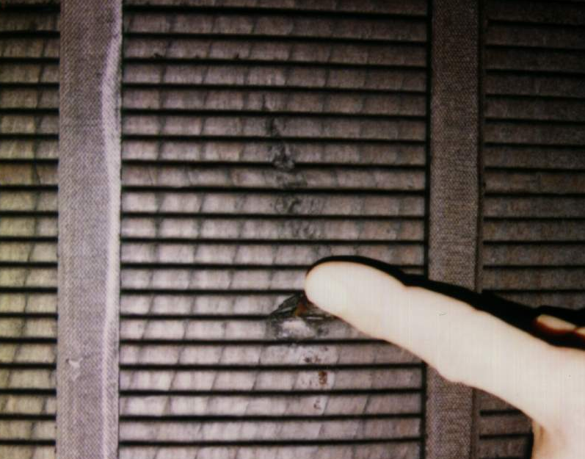

Slide 7
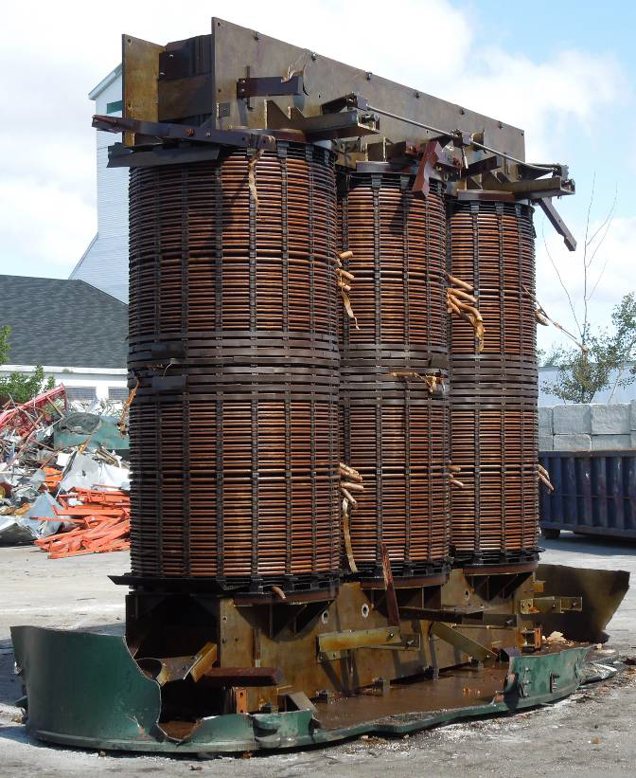
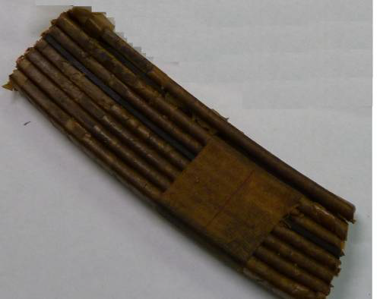
.

Slide 8
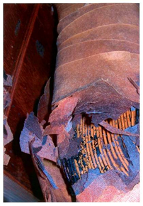
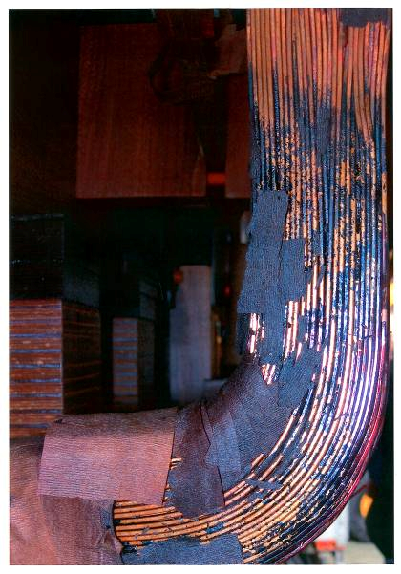
Paper deterioration by overheating
Thermally overstressed insulation

Slide 9
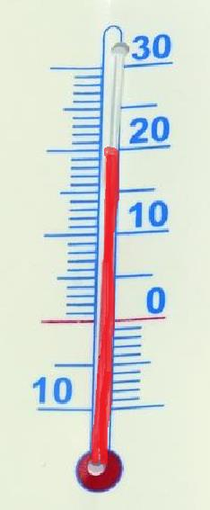

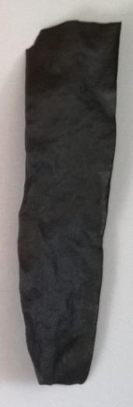


Slide 10
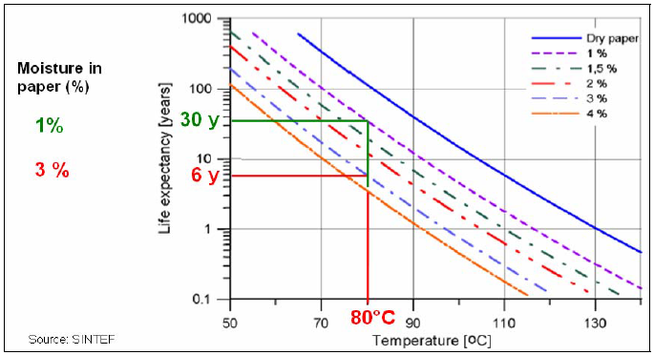
Influence of temperature combined with water on solid insulation life time
(Laboratory experiment on a Kraft paper sample)
(source: CIGRE A2-445, 2011)

Slide 11

End-of-life criteria should be associated with a higher risk of transformer failure
“strategic” end-of-life
“economical” end-of-life

Slide 12
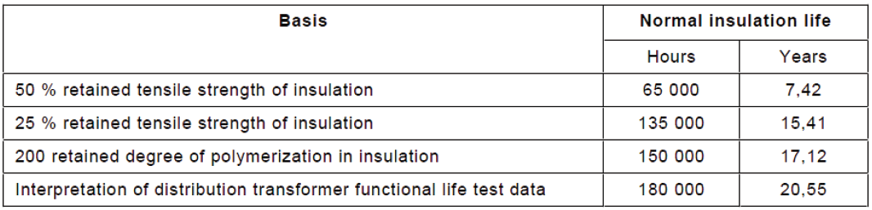
Normal insulation life of a well dried, oxygen free, thermally upgraded insulation system, at the reference temperature 110°C (IEC 60076-7:2005)

Slide 13
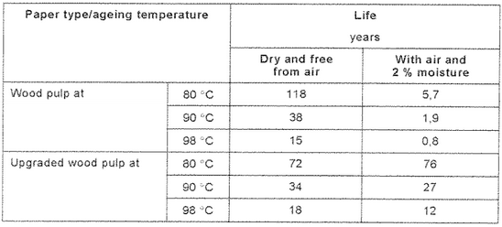
Life of paper under various conditions (IEC 60076-7:2005)

Slide 14
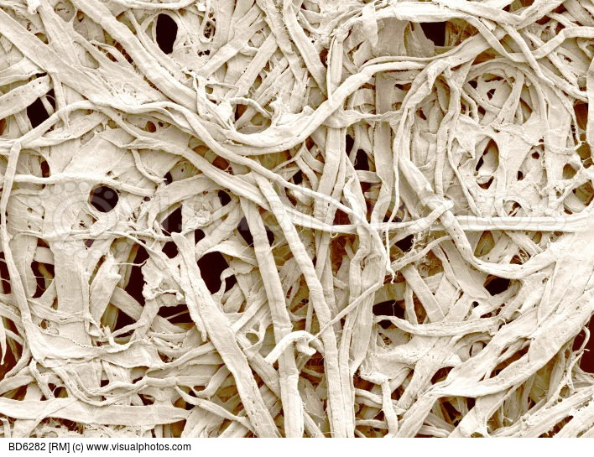

Slide 15
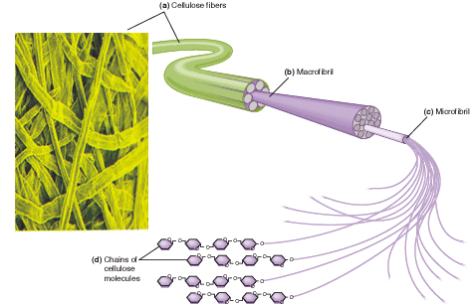

Slide 16
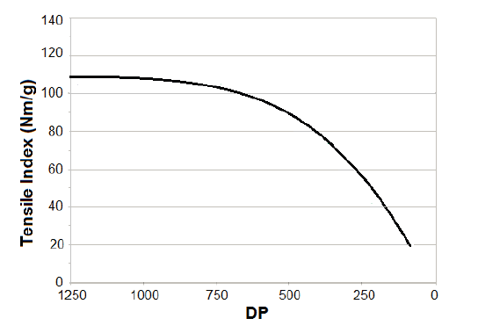
Diagnostics from paper: measurement of the average viscometric degree of polymerization
Degree of polymerization
Degree of polymerization
Typical correlation between tensile strength and degree of polymerization value for Kraft paper
(Source: CIGRE D1-111, 2012)

Slide 17
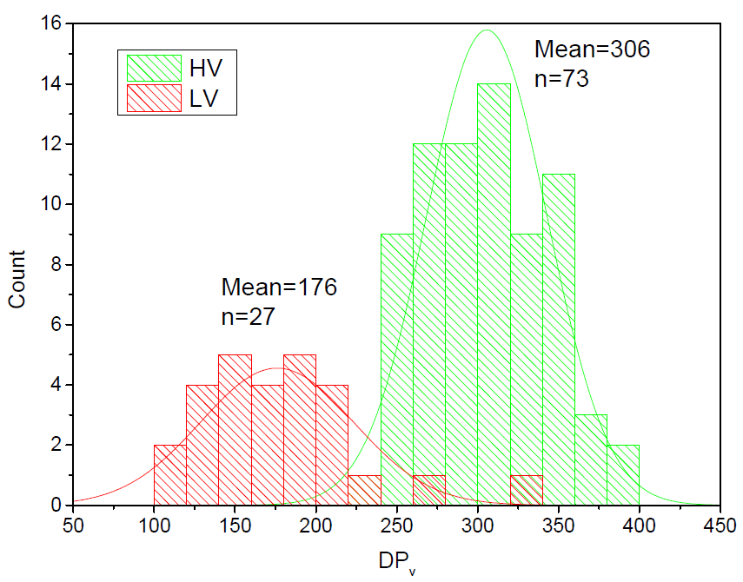
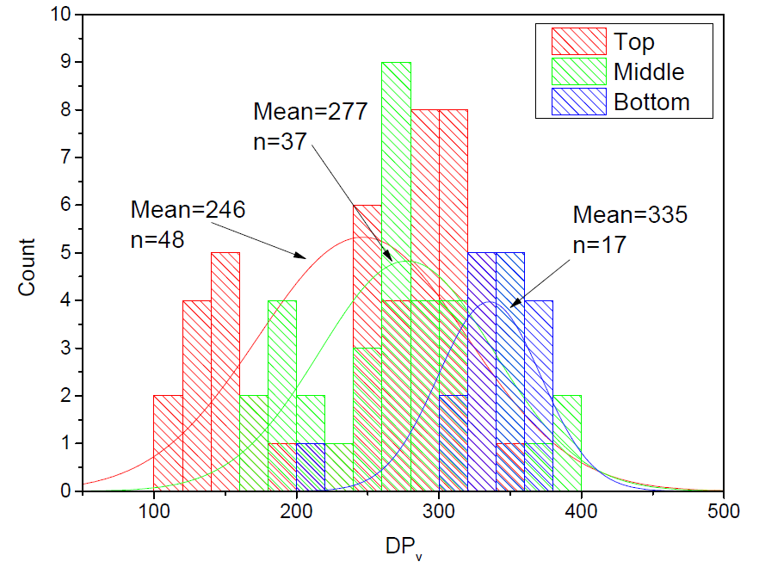

(Source: CIGRE A2-102,2014)

Slide 18
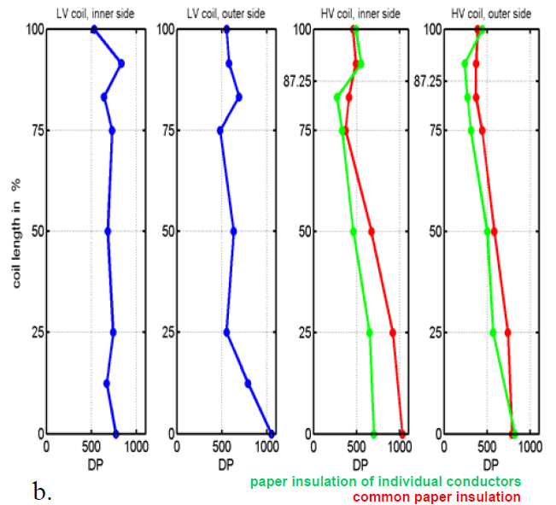
(Source: CIGRE A2-106,2014)

Slide 19
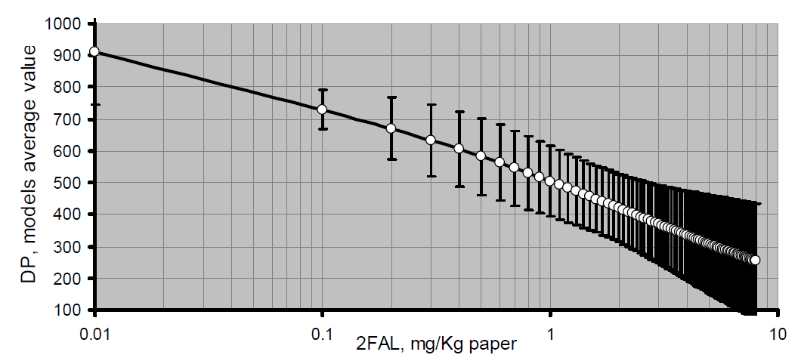
Diagnostics from oil: furan analysis
Typical correlation between degree of polymerization and furan content
(Source: CIGRE D1-494, 2012)
DP: degree of polymerization
2FAL: 2-furfural

Slide 20
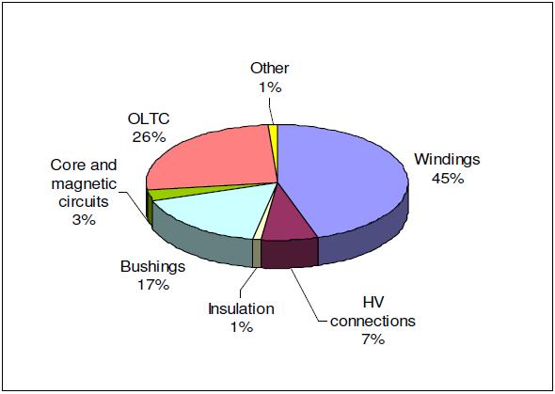
(source: CIGRE A2-107,2014)

Slide 21
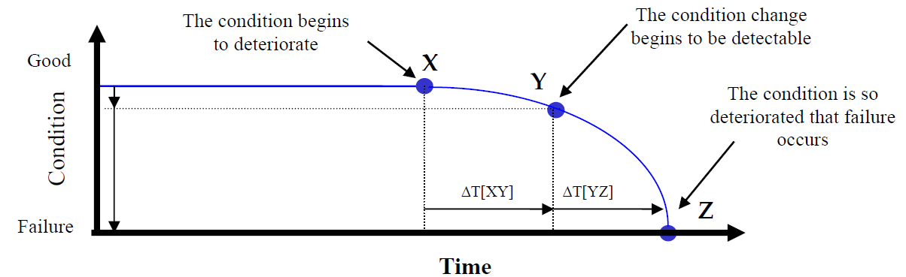
(Source: CIGRE A2-445, 2011)

Slide 22
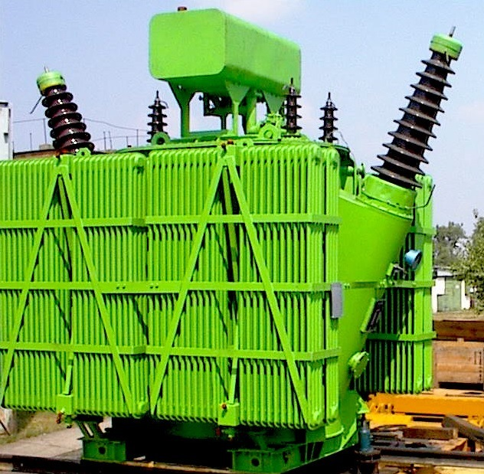
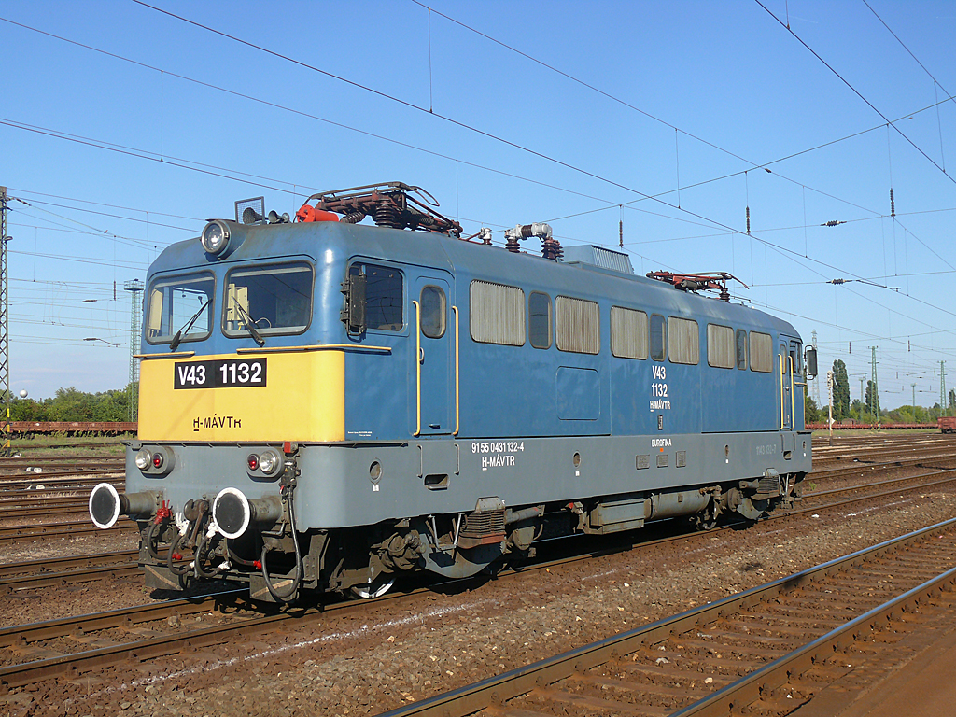
Diagnostics
in practice

Slide 23
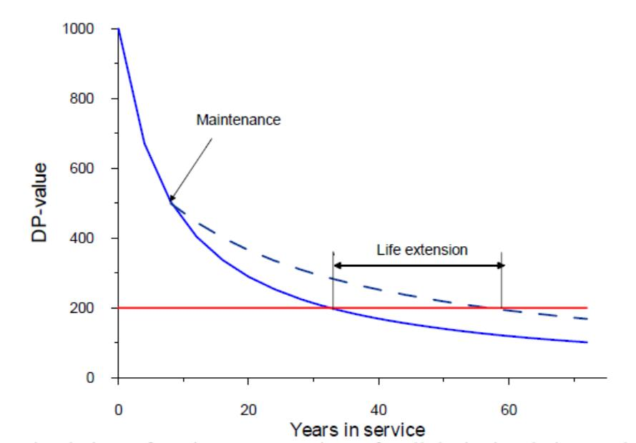
Simulation of maintenance action of cellulosic insulation and its effect on retarding ageing.
(source: CIGRE D1-323, 2007)

Slide 24
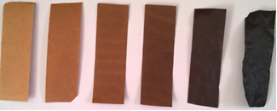







Lifetime of Kraft paper
…without maintenance
….with maintenance

Slide 25
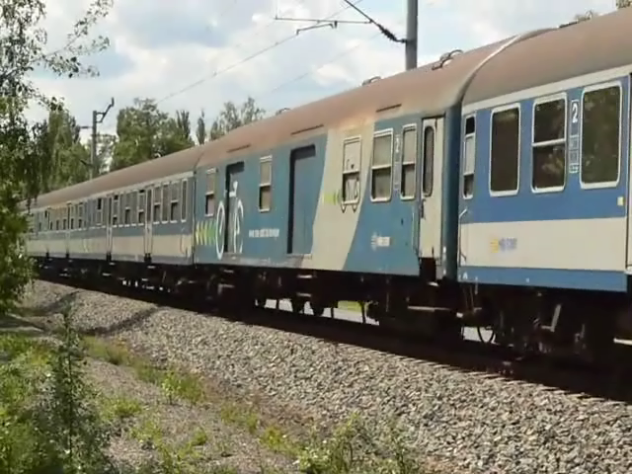

Slide 26
Thank you for your attention!
INNORAIL 2015
zsuzsagsz@gmail.com

